Slide 1
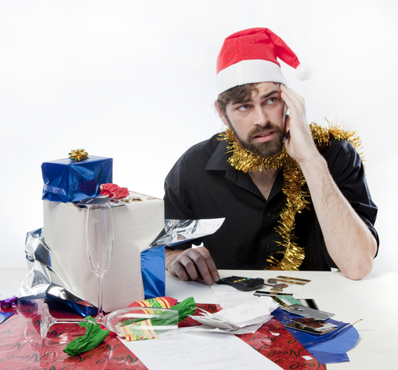
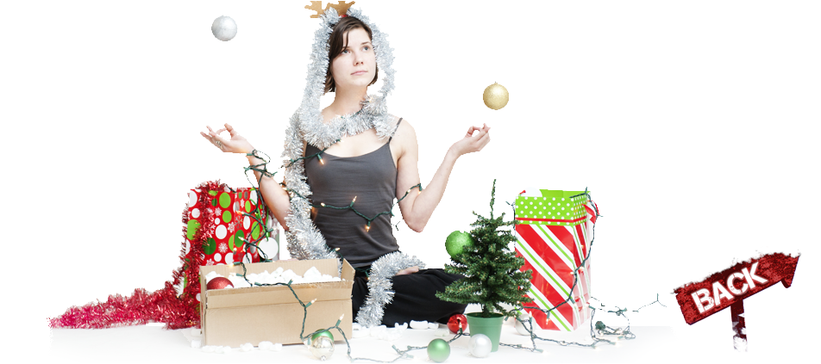
Health Holiday Eating & Stress
How to survive this holiday season
Julie Spilman, M.Ed., CHES, CHHC
Director of Health Education & Community Outreach
Relaxed
Stressed

Slide 2
What Stresses you out?
Family
Friends
Managing your time
Planning events
Holiday blues/memories
Eating
Gift Buying
Cleaning
Etc…

Slide 3
How Stress Can Effect My Health

Slide 4
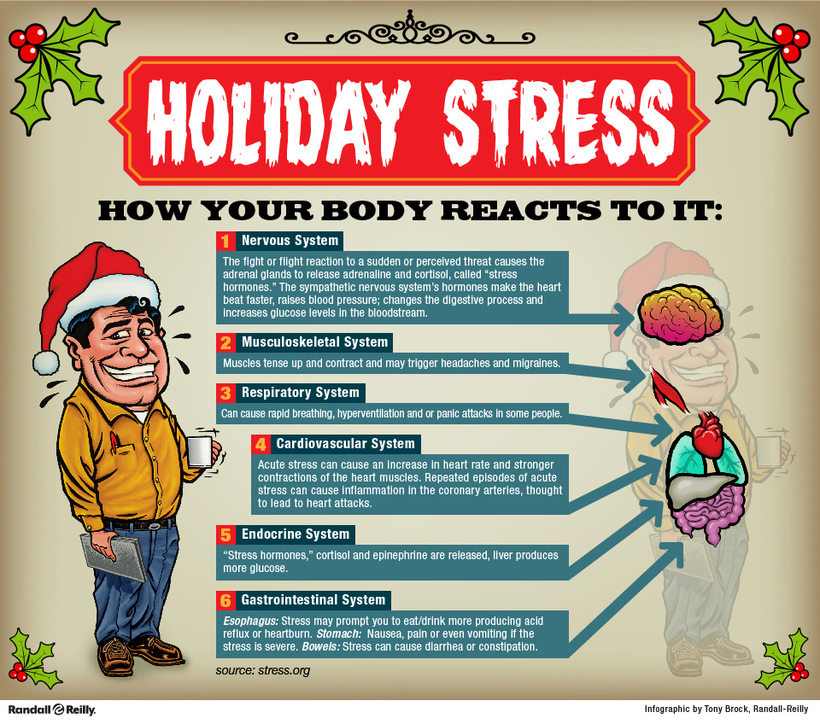

Slide 5
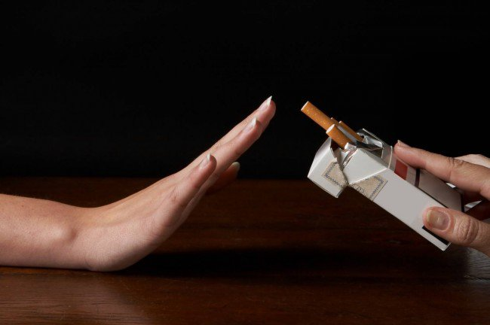
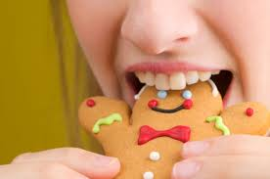
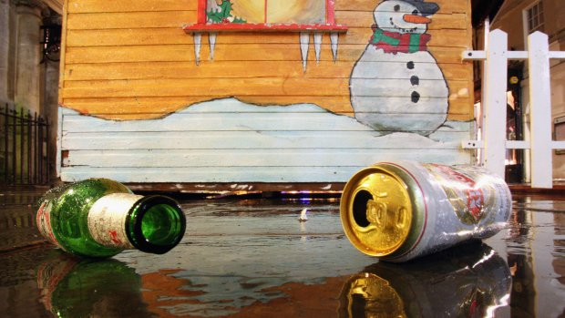
Be aware of Unhealthy Stress relief
Smoking
Drinking
Eating too much
Isolation

Slide 6
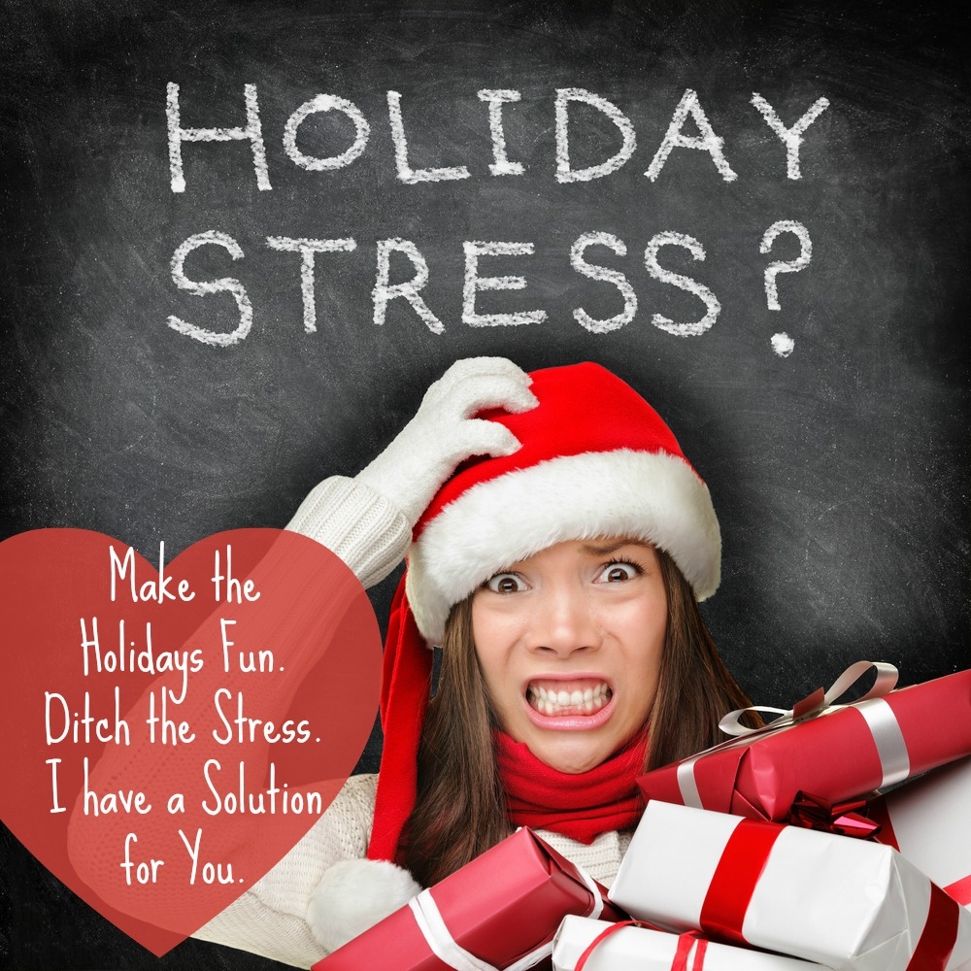
WHAT CAN WE DO?!

Slide 7
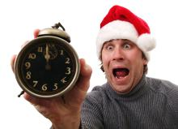
Create a Game Plan:
Spend a little time upfront getting organized.
4P’s: Prior Planning Prevents Poor Performance

Slide 8
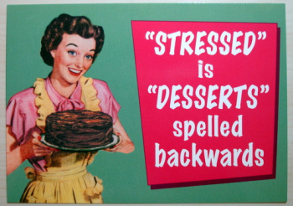
Make Time for your health:
Stay on normal sleep schedule

Slide 9
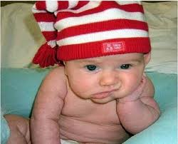
Give yourself a break:

Slide 11
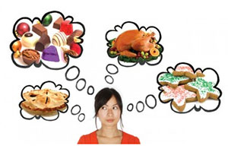

Slide 12
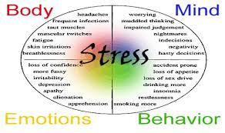
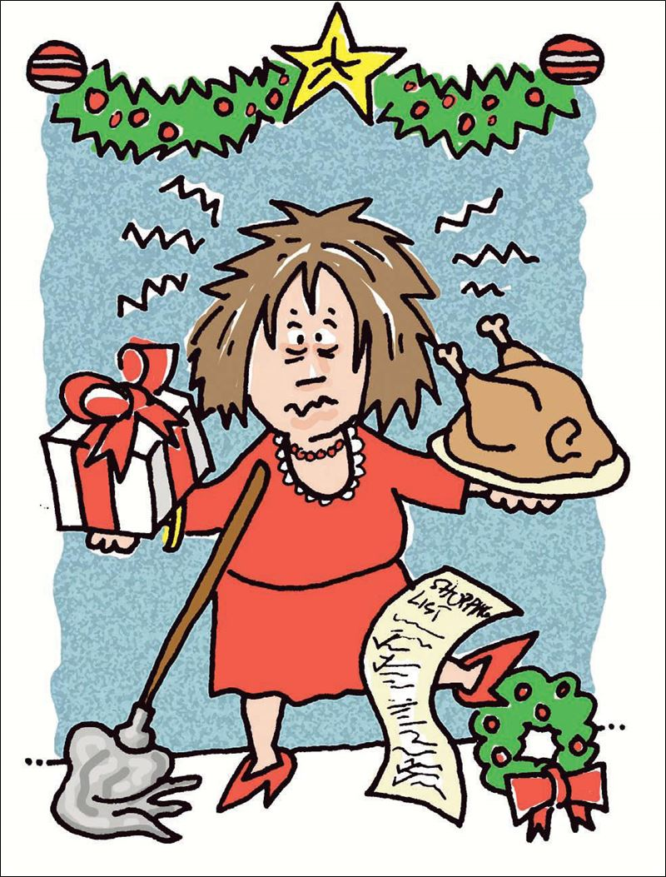

Slide 13
